Slide 1
CSC 439 Sprint Week 2
Jacob Moore, Zack Sprague, James Craig, Chris Wells, Joshua McGuire, Reed Inderwiesche

Slide 2
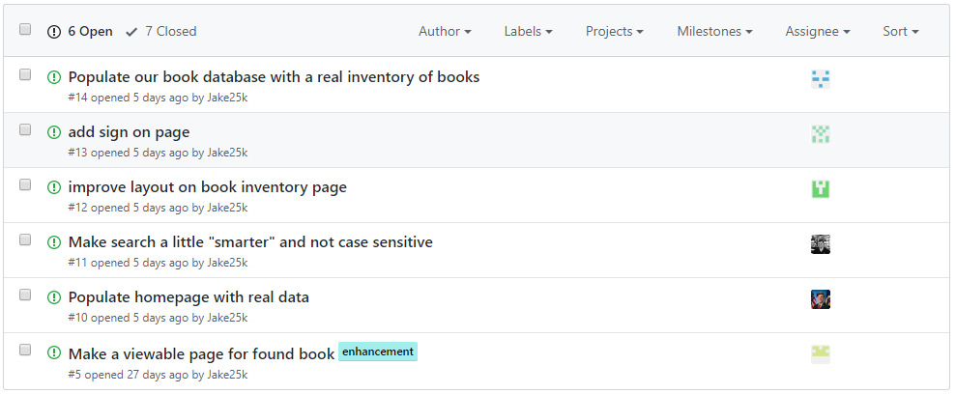
Issues from this week

Slide 3
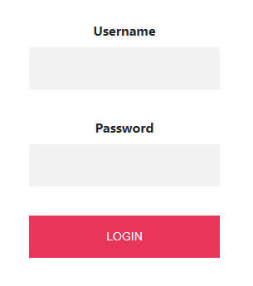

Team Lead/Developer: Zack Sprague
Task: 1. Set up users in the database
2. Added login button to all the html pages on the nav bar
3. Implemented the login form for users to create
accounts if not already signed up

Slide 4
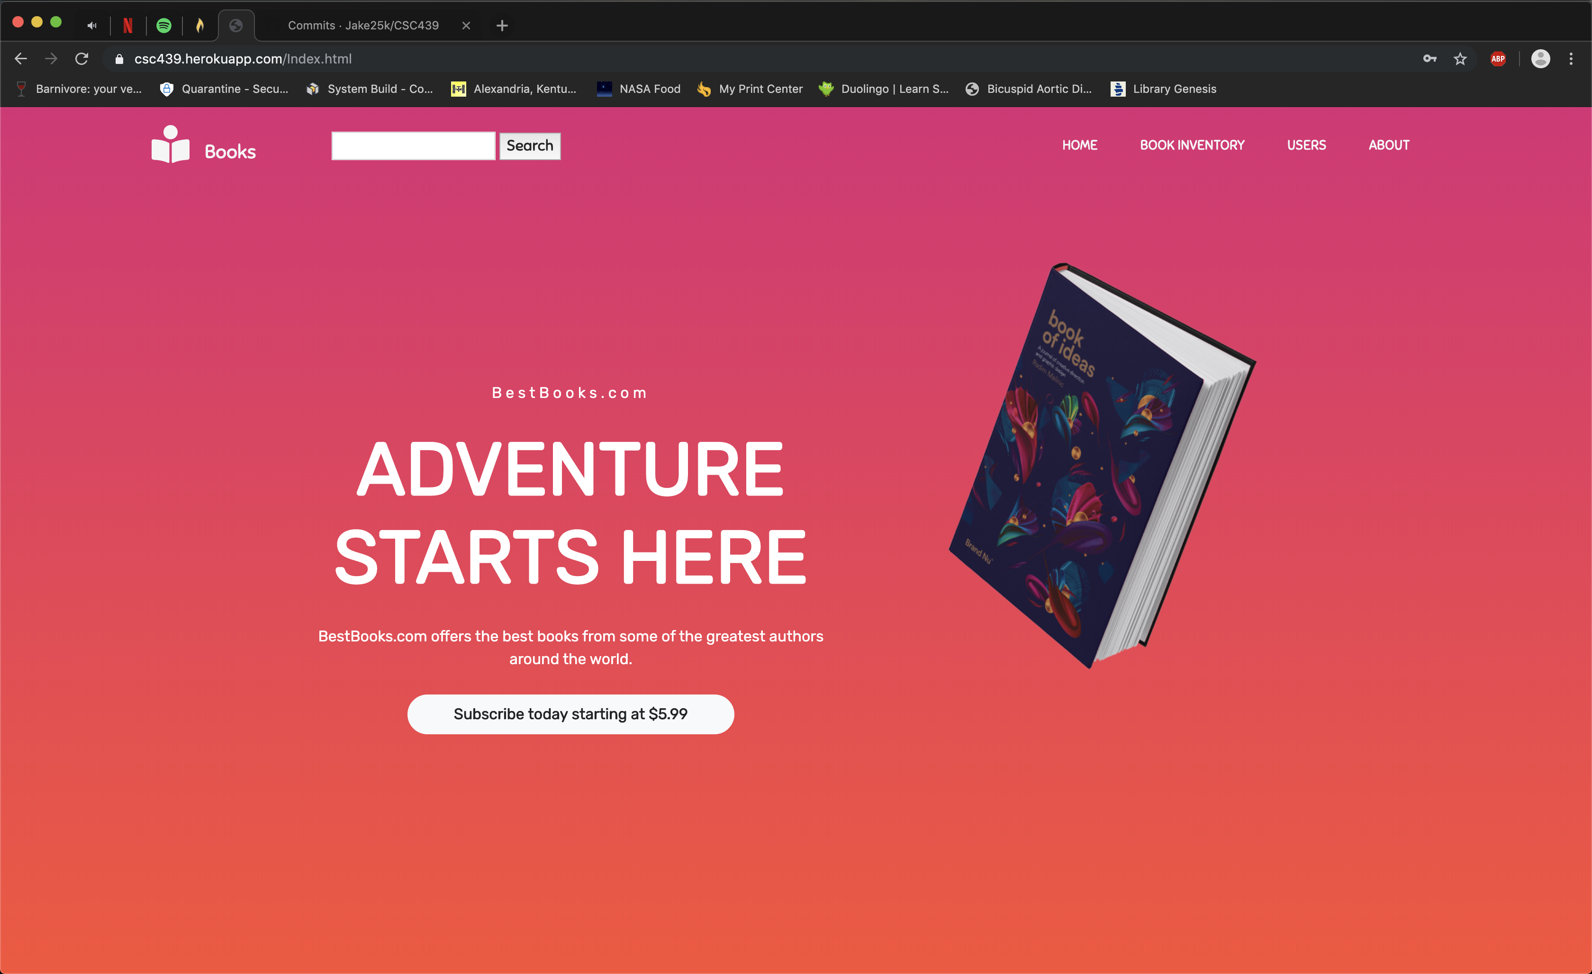

Tester/Developer: Jacob Moore
1. Added information to the homepage

Slide 5
Tester/Developer: James Craig
The goal for this sprint was to improve the appearance of our book listings
We wanted a responsive Bootstrap table for future addition of paginations

Slide 6
Modification of the Book Inventory Page
Original CSS
header{
padding-left: 5px;
background: var(--bggradient);
width: 100%;
}
table{
margin: 10px;
padding: 5px;
}
td{
padding-right: 15px;
}
Updated CSS
header{
padding-left: 5px;
background: var(--bggradient);
width: 100%;
}
h1 {
text-align: center;
}
table{
margin: auto;
padding: 5px;
width: 50% !important;
}
td{
padding-right: 15px;
}
centered-table{
margin-left: auto;
margin-right: auto;
}
.column-head{
text-align: center;
}
table.table-bordered{
border:2px solid black;
margin-top:20px;
}
table.table-bordered > thead > tr > th{
width: 75% !important;
border:2px solid black;
}
table.table-bordered > tbody > tr > td{
width: 75% !important;
border:2px solid black;

Slide 7
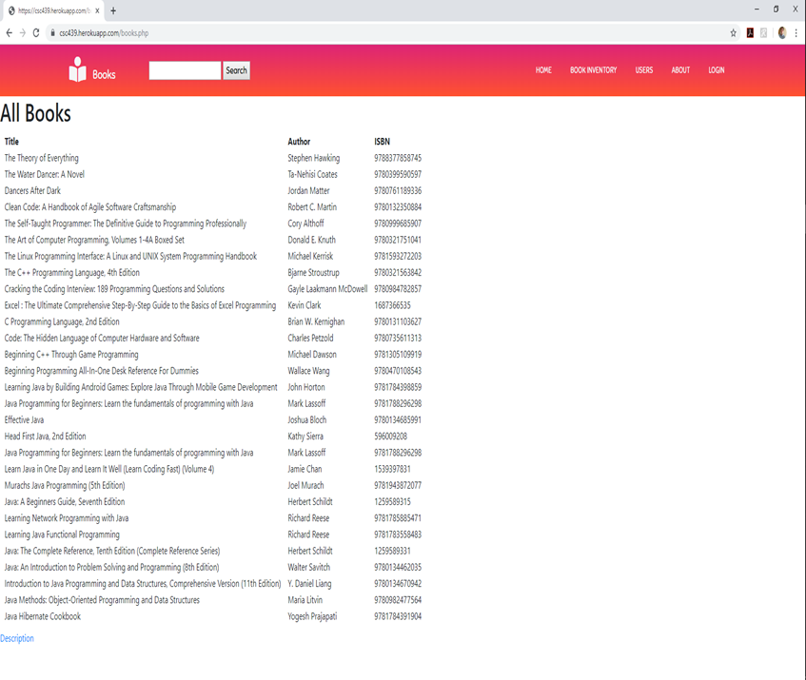
Modification of the Book Inventory Page
Original code for the output of the table
echo "<table>";
echo "<tr><th>Title</th><th>Author</th><th>ISBN</th></tr>";
while($results = pg_fetch_array($query, NULL, PGSQL_ASSOC)){
echo "<tr>";
echo "<td>" . $results['title'] . "</td>";
echo "<td>" . $results['author'] . "</td>";
echo "<td>" . $results['isbn'] . "</td>";
echo "</tr>";
}
echo "</table>";

Slide 8
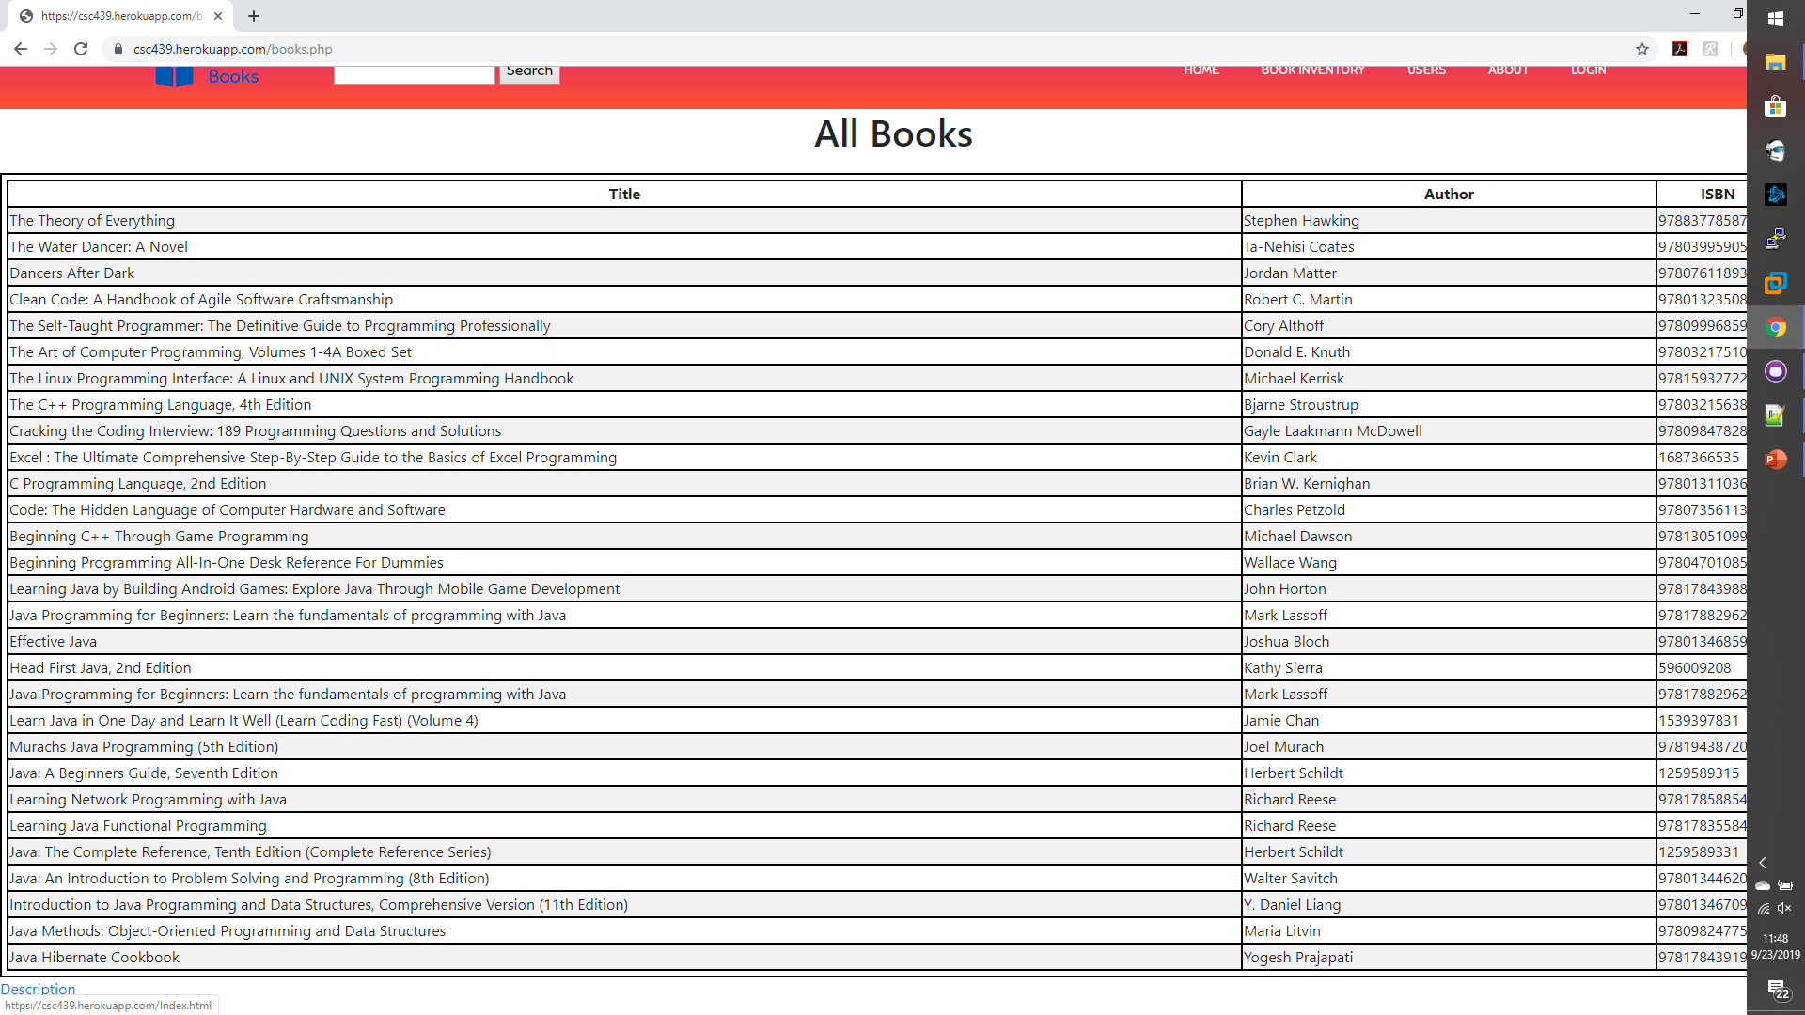
Modification of the Book Inventory Page
Updated code for the output of the table
echo "<table class=\"centered-table table-bordered table-striped table-hover table-responsive\">";
echo"<thead>";
echo "<tr class=\"column- head\"><th>Title</th><th>Author</th><th >ISBN</t h></tr>“;
echo "</thead>";
while($results = pg_fetch_array($query, NULL, PGSQL_ASSOC)){
echo "<tr>";
echo "<td>" . $results['title'] . "</td>";
echo "<td>" . $results['author'] . "</td>";
echo "<td>" . $results['isbn'] . "</td>";
echo "</tr>";
}
echo "</table>";

Slide 9
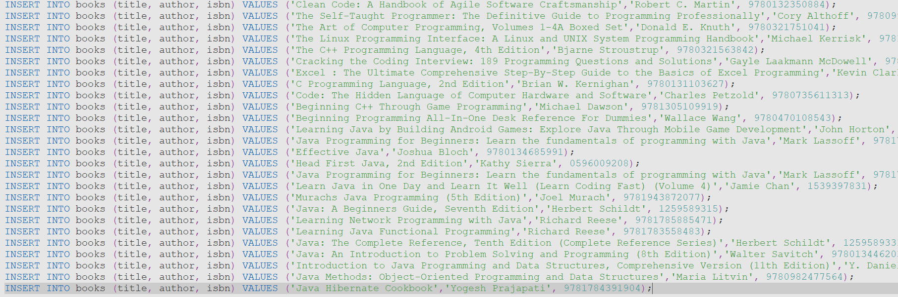
SCM Manager/Developer: Reed Inderwiesche
Tasks:
Added data to the books table in the database.
Generated a books.sql script using data scraped from Amazon book listings

Slide 10
Build Manager/Developer: Chris Wells
Task:
Made searching case-insensitive
Added a Combo Box to allow the user to search between the Title, Author, or ISBN.

Slide 11
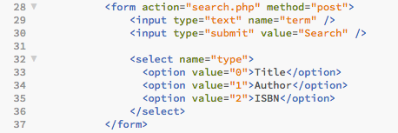
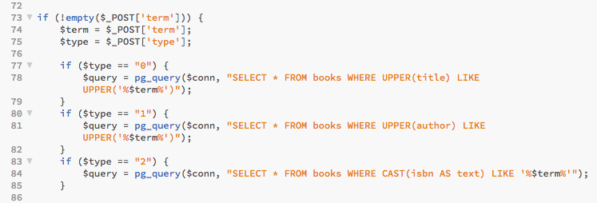
Build Manager/Developer: Chris Wells

Slide 12
Tester/Developer: Josh McGuire
Fixed descriptions.php to properly display webpage instead of giving a html 500 error.
Displayed a price and a description of books hard coded in.
To-do: Have descriptions be used by the data base and have SQL query the database for just book selected.

Slide 13
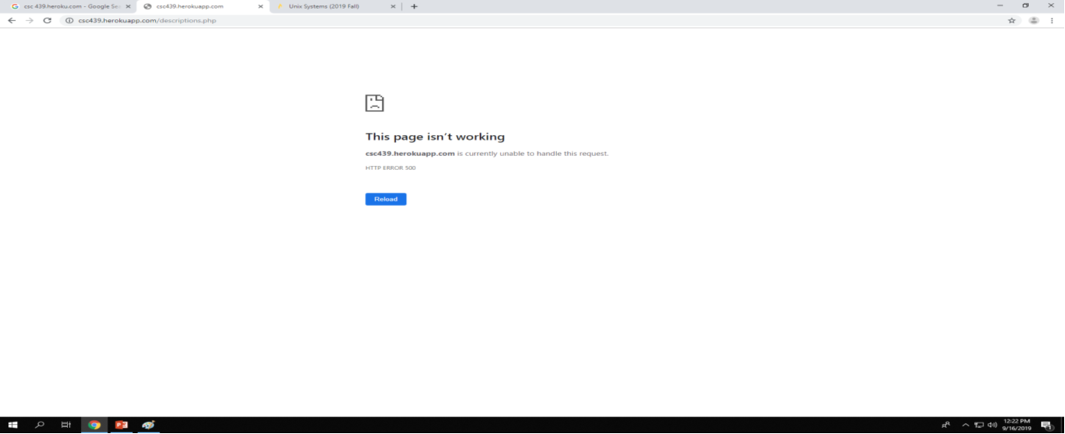
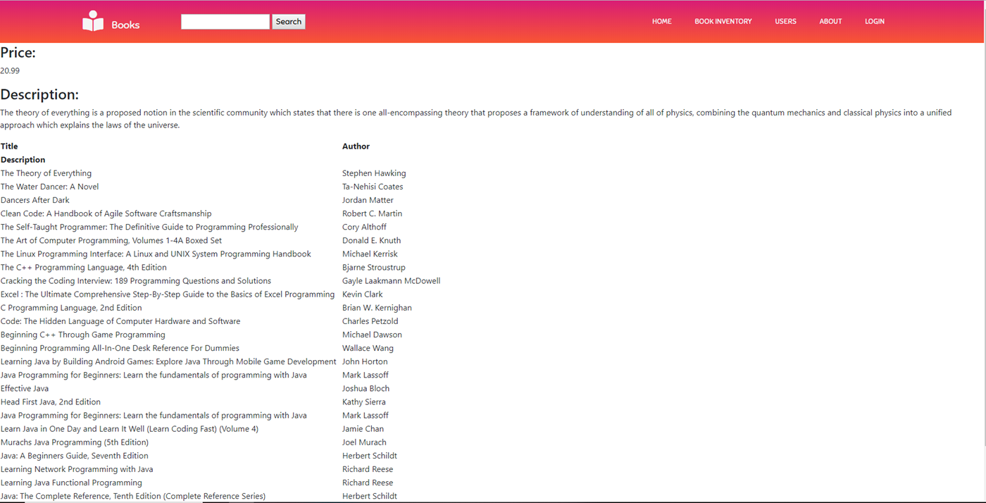
Tester/Developer: Josh McGuire

